Slide 1

EXPOSYS DATA SCIENCE PROJECT
MOHAMMAD ADIL

Slide 2

PROBLEM STATEMENT:
Prepare an ML model which can predict the profit value of a company if the value of its R&D Spend, Administration cost and Marketing Spend are given

Slide 3
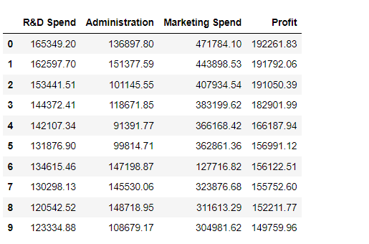
DATASET
FOR THE PROBLEM STATEMENT, WE ARE GIVEN A DATASET WHICH HAS PROFIT VALUE OF 50 STARTUPS. THE PROFIT VALUES DEPEND UPON THREE FACTORS : R&D SPEND, ADMINISTRATION COST AND MARKETING COST.

Slide 4

REGRESSION USED:
1. LINEAR REGRESSION
2. RIDGE REGRESSION
3. STOCHASTIC GRADIENT DESCENT
4. RANDOM FOREST
5. DECISION TREE
5. XGBOOST
6. GRADIENT BOOSTING

Slide 5

REGRESSION METRICES
1. R2 SCORE
2. MEAN ABSOLUTE ERROR
3. MEAN SQUARED ERROR
4. MEAN SQUARED LOG ERROR
5. MAX ERROR
6. EXPLAINED VARIANCE SCORE

Slide 6
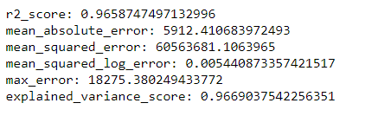
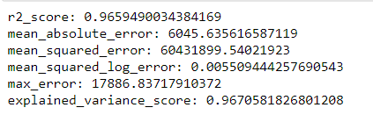
CALCULATIONS:
FOR LINEAR REGRESSION:
SCORE: 0.965874749132996
FOR RIDGE REGRESSION:
SCORE: 0.9659490034324169

Slide 7
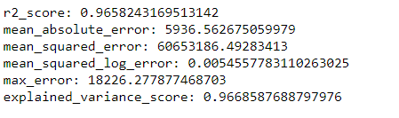
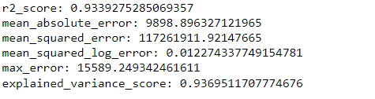
FOR SGD:
SCORE: 0.9658243169513142
FOR RANDOM FOREST:
SCORE: 0.9339275285069357

Slide 8
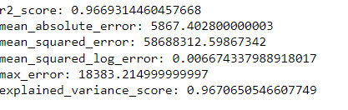
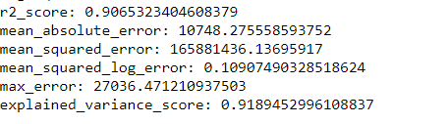
FOR DECISION TREE:
SCORE: 0.9669314460457668
FOR XGBOOST:
SCORE: 0.9065323404608379

Slide 9
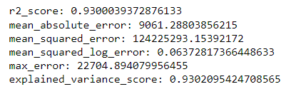
FOR GRADIENT BOOSTING:
SCORE: 0.9300039372876133

Slide 10

RESULT
On calculating the evaluation metrices for each of models, we find that the prediction score is best for Decision tree and it’s approximately close with Stochastic gradient descent and ridge/Linear Regression.
So, for our given dataset we can use any of the above three regression models to predict the profit values for the startups

